Slide 1
1 Planed
Planed 1
Watch the video slips from 1 to 20 , three slips a day.
4

Slide 2
1 Results
Results 1
Just to the tenth slip.
I learned the basic commands of assembly language , and how to draw the view of stack.
4

Slide 3
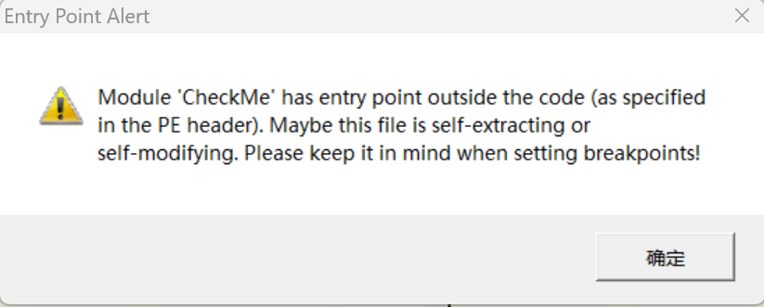
1 Challenges and Solutions
Challenges and solutions 1
I open a executable file by DTDDebug , there is a warning for it.
The warning is related with the relocation table in PE format?
4

Slide 4
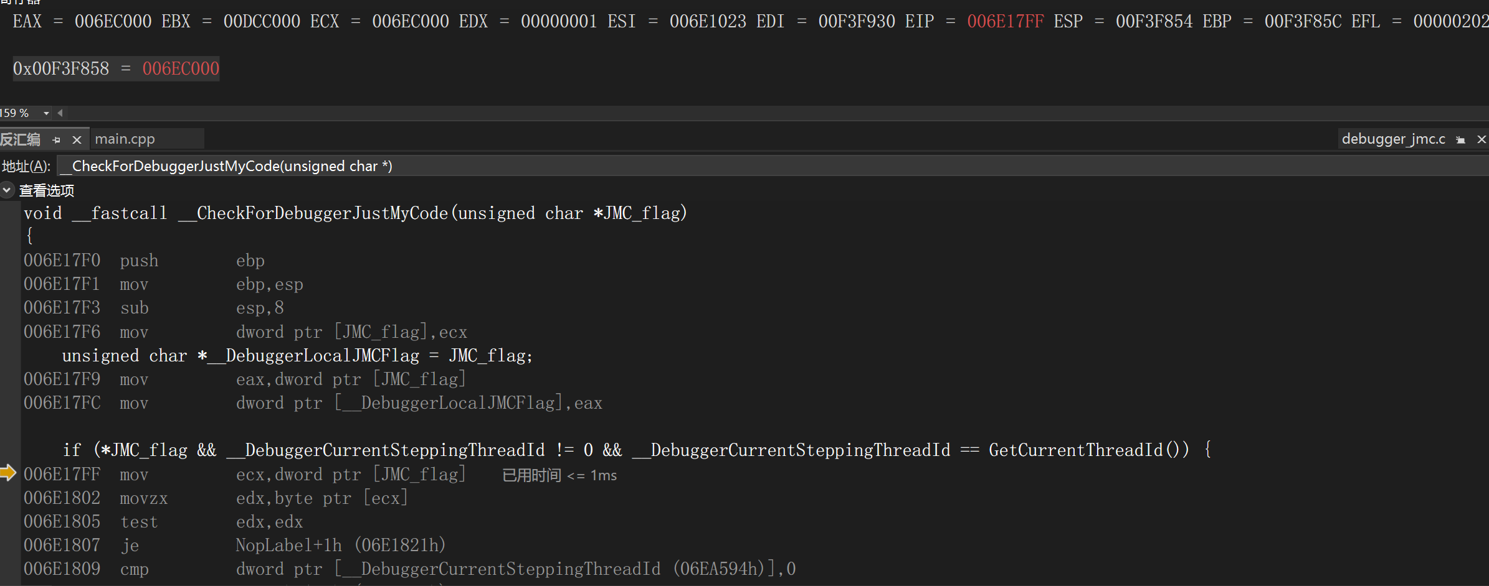
2 Challenges and Solutions
Challenges and solutions 2
If the register is not enough to store data , then it will allocate a memory for the data?会的
4

Slide 5

3 Challenges and Solutions
Challenges and solutions 3
The command `cmp` will influence the command `call` ?
What is the function of this operation? To judge if the stack is balanced or not?
4

Slide 6
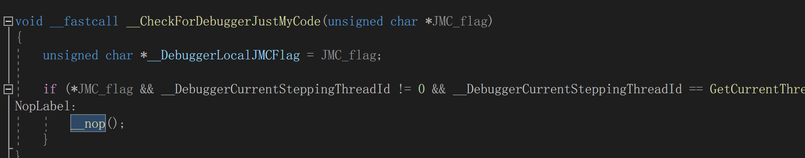
4 Challenges and Solutions
Challenges and solutions 4
What is the function of it ? It is used by vs in the debug version.
4

Slide 7
1 Plan
plan 1
Two slips a day watch from 10 to 24 . Finish the study of x86 assembly language.
4

